Slide 1
Unit5: Syntax Directed Translation
Syntax Directed Translation

Slide 2
Syntax Directed Translation
Method of compiler implementation where the source language translation is completely driven by the parser.
Translating a string into a sequence of actions by attaching one such action to each rule of a grammar.

Slide 3
Role of SDT
To associate actions with productions
To associate attributes with non-terminals
To create implicit or explicit syntax tree
To perform semantic analysis

Slide 4
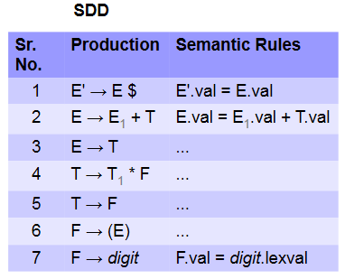
SDD for Calculator

Slide 5

SDD for Calculator

Slide 6
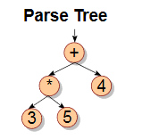
SDD for Calculator

Slide 7
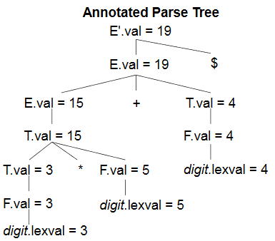
SDD for Calculator

Slide 8
Attributes
Synthesized Attribute
Value of the attribute computed from the values of attributes of grammar symbols on RHS.
Inherited Attribute
Value of attribute computed from values of attributes of the LHS grammar symbol.
Actions associated with each production in a grammar.
Actions
Associated with each production in a grammar.

